Slide 1

MOBILE APPLICATION Development (114155)
Dr. Owais Hussain

Slide 2

Agenda
Introduction to React
Pre-requisites
Creating a React App
React Components
Props
Styling in React
Handling Events

Slide 3
Agenda
Unidirectional Data Flow
States/State Hook
Linking and Routing
Managing Assets

Slide 4
Sample 2
Introduction to React
Facebook, after spending a decade on its first version on PHP moved to a home-built Web App library
Facebook, Instagram, Messenger, Airbnb, …
React is an open-source JavaScript Library with a strong community and plenty of 3rd party plugins
NOT an OOP language. Rather uses Compositions (like Legos)
React is NOT like AngularJS
Single-Page Apps
Virtual DOMs, the heart of React
Notes:
Angular JS is one stop shop for building SPA’s. React is only a client-side library and uses plenty of 3rd party components like Redux and Axios to achieve the same objectives.
These days, JS libraries and frameworks are popping like corn in microwave oven. I hear good things about Next.JS and Bun, but as a beginner, you must be cautious.
React updates DOM only when needed, otherwise in-memory virtual DOMs are used.
Visit https://create-react-app.dev

Slide 5
Sample 2
DOM
DOM or Document-Object Model is one of the bottlenecks when using JavaScript to interact with HTML.
HTML document is a file in XML format.
JavaScript is a programming language which uses objects.
Both are incompatible. Therefore, DOM is used to act as a broker. In the simplest terms, DOM is a data structure, which converts a JavaScript object into HTML document and vice versa.
The problem? Each time there’s a change in JavaScript object, the DOM must be updated and search/update in an HTML document is slow.
Notes:
Bear in mind that the virtual DOMs are not required for non-SPA’s as the whole document gets refreshed on each action anyway.

Slide 6
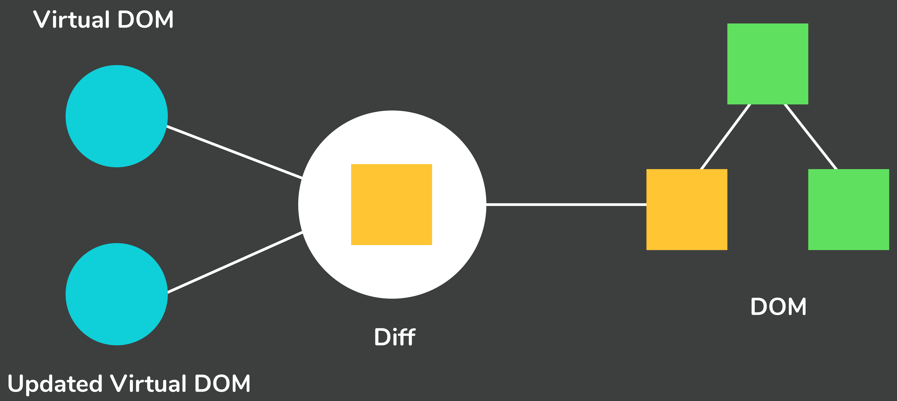
Sample 2
Virtual DOM
React’s solution. Keep a copy of DOM in memory as tree.
Web page is compared with V-DOM on event triggers to see which element to update.
Update the actual DOM when necessary, in the background.
Notes:
Bear in mind that the virtual DOMs are not required for non-SPA’s as the whole document gets refreshed on each action anyway.

Slide 7
Sample 2
Pre-requisites
HTML5
Layouts and Styles
Text formatting and lists
Images, linking and metadata
CSS
Font Styling, Colours and Icons
Flex Box Layouts
CSS Selectors
Position, Padding, Margins
JavaScript ES6
Data types
Using var, let, const
Conditions and loops
Objects, arrays, functions
Arrow functions
map(), reduce(), forEach()
Promises
Error handling
Package Manager (Node + npm)
Create, install, run, update commands

Slide 8
Sample 2
Creating a React App
Install Visual Studio Code
Install Extensions: “Code Runner”, “Live Server”, “HTML CSS Support”, “HTML Snippets”, “ES7+ React/Redux/React-Native snippets”
Install Node.JS
On windows 11, you can use “winget install node.js”
Check versions: “node --version && npm --version”
Create Baham React App: “npm create-react-app baham” on VSCode Terminal
Go to the newly created directory: “cd baham”
Run the app: “npm start”
The default app should launch on your Browser window
Notes:
The npm comes with Node.JS as a package manager for people to share their code packages.

Slide 9
Sample 2
Before we begin
React has Component classes.
class MyComponent extends React.Component {}
React also has functional components.
function MyComponent() {}
We will use functional components because they use Hooks.
Hooks allow us to manipulate the state of a component outside constructors in fewer lines of code.

Slide 10
Sample 2
Before we begin
Some common must-know ES6 features:
Array methods: map(), forEach(), reduce().
const arr = [2, 3, 5, 8];
const sqrd = arr.map(x => x * x); // sqrd = [4, 9, 25,64]
const sum = arr.reduce((accumulator, x) => accumulator + x); // sum = 18
const even = arr.filter(x => x % 2 == 0); // even = [2,8]
arr.forEach(x => alert(x)); // 4 alerts showing each number
Destructuring: assigning array values to separate variables
const two, three, five, eight = arr; // two = 2, three = 3, five = 5, eight = 8
Spread operator
const first, second, …rest = arr; // first = 2, second = 3, rest = [5, 8]

Slide 11
Sample 2
Creating a React App
Code Structure
node_modules folder: contains some packages provided by Node.JS which are required by React
public folder: contains different static assets for the app
src folder: contains all source files
App.css contains styles used in the entire app
App.test.js and setupTest.js provide unit testing
reportWebVitals.js are related to performance testing
The index.js file is the most important file, which attaches the components to root element
package.json file contains all metadata about the application
package-lock.json is a saved state of package.json file so that the project can be rebuilt
Notes:
Package file contains information including name, version, dependency libraries, settings for development, testing and production environments, and more
README.md is Markdown file for project documentation.
.gitignore is used by Git to skip all files and directories which will not be tracked.

Slide 12
Sample 2
React Components
A React App is composed of several independent, reusable, pluggable Components
Components act much like a JavaScript objects
Header, Footer, Navbar, Side bar, Main section, Sub-sections within Main, etc. are all separate components
React components can be exported and imported
Exporting single Component: “export default {MyComponent};”
Exporting multiple Components: “export default {Component1, Component2};”
If your file name is same as the component name, you can simply do: “export default MyComponent;”
Notes:
The npm comes with Node.JS as a package manager for people to share their code packages.

Slide 13
Sample 2
React Components
Functional Components
function Hello() { return <h1>Hello Baham</h1> }
Class Components (deprecated approach)
class Hello extends React.Component {
render() { return <h1>Hello Baham</h1> }
}
The “root” element is mandatory. The same as in public/index.html file
The App.js component is attached to root and rendered
Variables can be accessed within tags using curly brackets {}
React Transpiles the JSX code into HTML
Notes:
Switch to VSCode and explain index.js
The HTML-looking code inside App.js is NOT HTML, but JSX (JavaScript XML). It’s a combination of JavaScript and HTML tags. JSX is case-sensitive.
The component names must start with Capital letter. Low-case components are considered regular HTML elements by React
Transpiling is the process of interpreting code from programming language and translating into code of another programming language. Babel is a popular JS transpiler.

Slide 14
Sample 2
React Props
Props are properties used to pass on data from parent component to its children.
For props to work, the child component should accept “props” in parameter and use its properties like: {props.sittingCapacity}
The parent component sets these properties when calling child component like: <Vehicle sittingCapacity=4 />
Props can be used to pass literals, objects, styles, JSX expressions, and even functions
DIY: Learn about special props: props.children

Slide 15
Sample 2
Unidirectional flow
In react, the data flows from parent to child components. This is why props are immutable (unchangeable)
Why?
Consistency: if parent is assigning value for child, and child is then also assigning value for parent, other children will have inconsistent data.
Simplicity: the implementation logic is simplified, and the code is more readable.
function User() {
let status = "active";
return (
<div>
<Owner name="Ali" status={status} />
<Companion name="Dua" status={status} />
<div/>
);
};
function Owner(props) {
return (
<div>
<h2>{props.name} is {props.status} />
<div/>
);
};
// What will happen if Owner changes the status?
Notes:
If the child component is allowed to change the status to “inactive”, then Companion may or may not have “inactive” as its status, depending on whether Owner has changed the status or not. This will basically turn status into a global variable, which leads to inconsistent behaviour.

Slide 16
Sample 2
States / State Hook
Props do not allow child to change a parent property pushed to it via props. States are an alternative, which are mutable.
A state consists of single property and its handler function that sets its value. Child components can call the handler function to set the parent value.
The given example uses states to input passenger names in an input text and add them to list of passengers of a vehicle on button click. The button is disabled as soon as all seats are full.

Slide 17
Sample 2
States / State Hook
import './App.css'; // Import CSS
import { useId, useState } from 'react'; // Import hooks
function App() {
// Render Vehicle component as child and pass 3 values in props, the last one is an object representing vehicle owner
return (
<div className="App">
<h1>Welcome to Baham</h1>
<Vehicle car="White Honda Vezel (HVZ-888)" seatsAvailable={3} owner={ {name: "Owais", role: "Owner"} } />
</div>
);
}
Cont.. on next slide

Slide 18
Sample 2
States / State Hook
const Vehicle = (props) => {
const [passengers, setPassengers] = useState([props.owner]); // State hook, passengers is initialized as array
const [nameInput, addButton] = useId(); // Id hook is used to track elements by their Id
// Click handler
function addCompanionButtonHandler(e) {
const name = document.getElementById(nameInput).value; // Get the value entered in the input box
const newPerson = {name: name, role: "Companion"} // Create new object to be pushed to passengers
setPassengers([newPerson, ...passengers]); // Prepend the new object to passengers list
document.getElementById(nameInput).value = ""; // Empty the text box
document.getElementById(addButton).disabled = passengers.length === props.seatsAvailable; // Disable if limit reached
}
return (
<div>
<h2>{props.car}</h2>
<input id={nameInput} placeholder="Companion name"></input>
<button id={addButton} onClick={addCompanionButtonHandler}>Add new Companion</button>
<ul>
{/* Use map function to populate items in passengers list */}
{passengers.map(person => (<li key={person.index}>{person.name} - {person.role}</li>))}
</ul>
<p>Total passengers: {passengers.length}</p>
</div>
);
}
export default App;

Slide 19
Sample 2
Linking and Routing
Single Page Applications are designed to dynamically update only the parts of the page as required.
React does not use Anchor tags, as they refresh the whole page. Instead, a list of Routers are defined, which are then used in Link JSX tags:
<Link to='/' className="Navbar-item" >Home</Link> <Link to=‘/about-us' className="Navbar-item" >Home</Link> <Routers> <Router path=“/” element={<Home />}> <Router path=“/about-us” element={<AboutUs />}> </Routers>
React loads one or more components in the root element at a time, depending on what routes the links are pointing to.
Notes:
Routers are not built-in. You need to install them using: npm install react-router-dom@6

Slide 20
Sample 2
Linking and Routing
import '../App.css';
import {Link, Route, Routes } from 'react-router-dom';
import App from '../App';
function NavigationBar() {
return (
<div className="Navbar">
<ThemeToggler />
<Link to='/' className="Navbar-item">Home</Link>
<Link to='/about-us' className="Navbar-item">About Us</Link>
<SearchBar />
<Routes>
<Route path='/' element={<App/>} />
<Route path='/about-us' element={<AboutUs/>} />
</Routes>
</div>
);
}
export default NavigationBar;

Slide 21
Sample 2
Managing Assets
Assets are resources used by components at runtime. These can be images, style sheets, fonts, and other media files.
Icons, logos, Generally kept in public folder. For the rest, we create a folder named “assets”.

Slide 22
Sample 2
Managing Assets
Assets are resources used by components at runtime. These can be images, style sheets, fonts, and other media files.
Icons, logos, Generally kept in public folder. For the rest, we create a folder named “assets”.
The assets can then be imported just like modules:
import suvicon from ‘./assets/images/suvicon.png’
… <img src={suvicon} alt=“An icon for an SUV” />
Alternatively (not preferably), you can use embedded assets directly:
… <img src={require(‘./assets/images/suvicon.png’)} alt=“An icon for an SUV” />

Slide 23
Sample 2
Extras
How to use React Bootstrap
Playing Youtube/Facebook videos using react player
<ReactPlayer>

Slide 24
Sample 2
Exercises
Create a new react app called exercises:
Create a component called Header and import in App. Header component should display a heading and a slogan.
Use props to set heading and slogan.
Use State hook to manage style of heading and slogan.
Add a button to App that switches theme between “Dark” and “Light” using event handlers.
Create a Navigation bar component and About Us component.
Use Routes and Links to load About Us component on press.

Slide 25



THANK YOU
Owais Hussain
+92 345-3174270
owais.hussain@kiet.edu.pk
https://www.researchgate.net/profile/Owais-Hussain-3

